Slide 1
DSC Prelim Exam Spring 2012 Problem 12 "Integration"

Slide 2
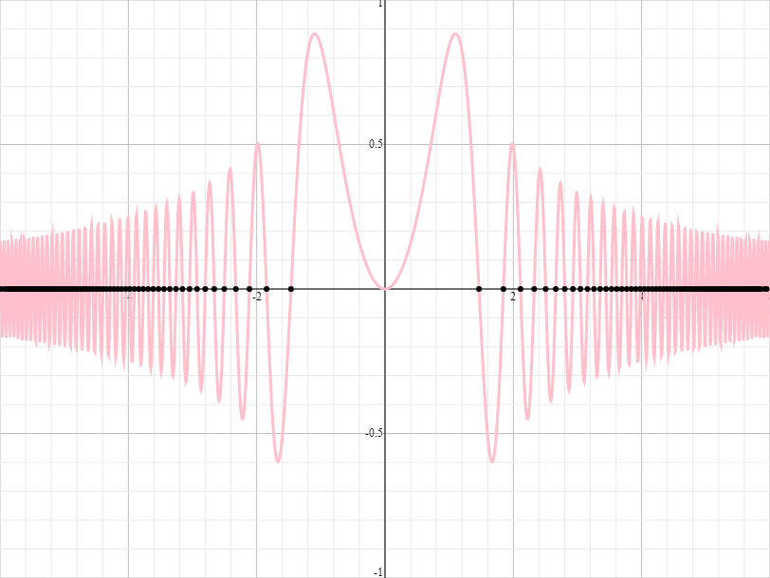
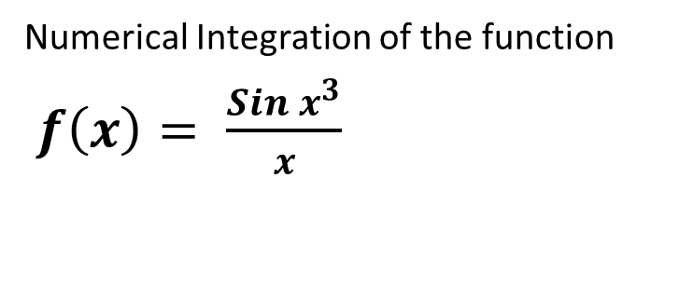
Numerical Integration of the function
$f\left(x\right)= \frac{Sin x^{3}}{x}$

Slide 3
Numerical Integration is a method to find the area between a curve and the x-axis.
The Basic Steps for Numerical Integration
1.) divide the x-axis into small pieces
2.) Calculate the value of f(x) at each small piece
3.) Multiply the width of the piece by f(x) to find the
area of the small piece
4.) Calculate the Sum of all of the small pieces.

Slide 4
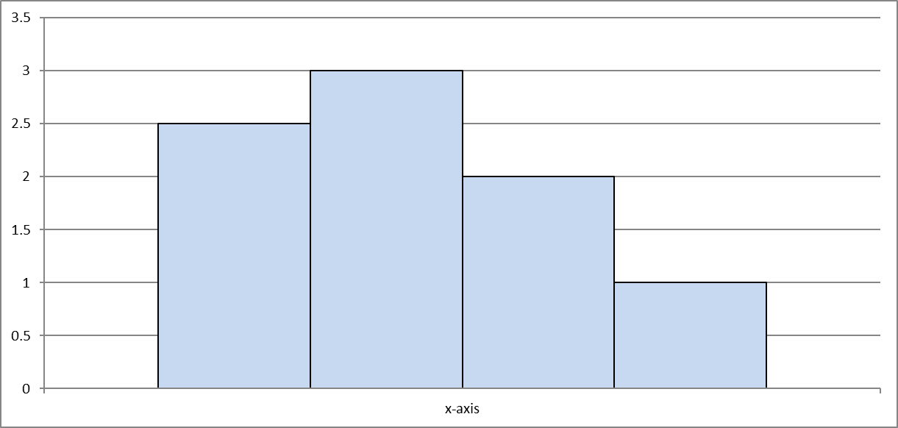

Mid-Point Composite Method Example
Choose N = 6; h = (b - a)/(N + 2) .
$Area = 2h∗f(x_{0})+2h∗f\left(x_{2}\right)+ 2h∗f\left(x_{4}\right)+ 2h∗f(x_{6})$
Mid-Point Method uses even values of N

Slide 5
Results of Mid-Point Composite Method
Midpoint Composite Method
N | Area
50 | 1.1454
100 | 1.2675
200 | 1.0392
400 | 1.0423
800 | 1.0429
1000 | 1.0429
2000 | 1.0430

Slide 6
%Mid-Point Composite Method
%Input an even integer for N
N = 1000;
% TO AVOID DIVISION BY ZERO, PROBLEM IS DIVIDED INTO LEFT AND RIGHT
%*******************************************************************
%Interval for x = [a,b] for LEFT SIDE
a = -5;
b = -0.01;
% Build x column vector for each step h ON THE LEFT SIDE
h = (b-a) / (N + 2);
x = zeros(N+1,1);
for i = 1:(N+1)
x(i,1) = a + (i*h);
end
%Calculate Area on Left Side
AREA_left = 0;
STEPS = (N/2) + 1;
for j = 1 : STEPS
n = ((j-1)*2) + 1; %the 1 keeps n from equalling 0
xn = x(n,1);
% Area equals function height times step width
AREA_left = AREA_left + (2*h) * func_1(xn);
end
%******************************************************************
%Interval for x = [a,b] for RIGHT SIDE
a = 0.01;
b = 5;
% Build x column vector for each step h ON THE RIGHT SIDE
h = (b-a) / (N + 2);
x = zeros(N+1,1);
for i = 1:(N+1)
x(i,1) = a + (i*h);
end
%Calculate Area on Right Side
AREA_right = 0;
STEPS = (N/2) + 1;
for j = 1 : STEPS
n = ((j-1)*2) + 1; %the 1 keeps n from equalling 0
xn = x(n,1);
% Area equals function height times step width
AREA_right = AREA_right + (2*h) * func_1(xn);
end
%*******************************************************************
% Add the Area on the left side to the Area on the right side
AREA = AREA_left + AREA_right;
AREA

Slide 7
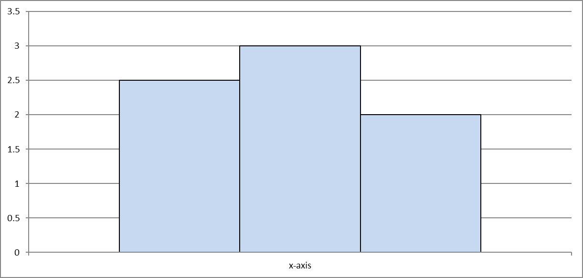
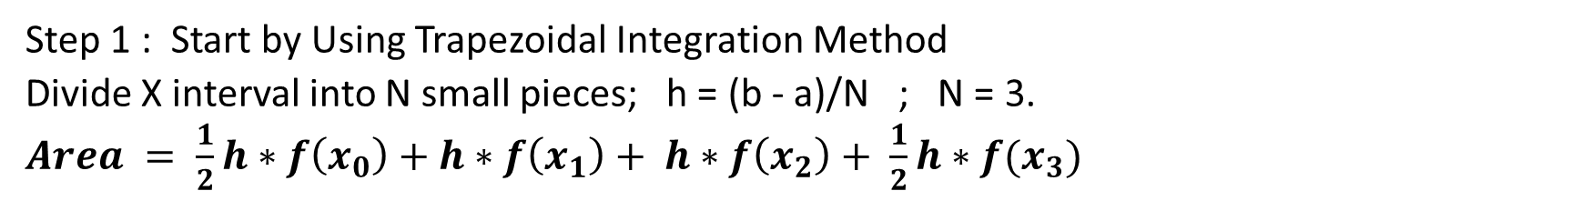
Romberg Integration Method Example
Step 1 : Start by Using Trapezoidal Integration Method
Divide X interval into N small pieces; h = (b - a)/N ; N = 3.
$Area = \frac{1}{2}h∗f\left(x_{0}\right)+h∗f\left(x_{1}\right)+ h∗f\left(x_{2}\right)+ \frac{1}{2}h∗f(x_{3})$

Slide 8

Step 2: Perform Trapezoidal Method with N = 1, 2, 4, 8, 16, ....
Use Romberg Equation to extrapolate results of Trapezoid Method.
$R_{i,j}=( 4^{j}) ( R_{i,j−1} − R_{i−1,j−1}$)/($4^{j}−1)$
j = extrapolation column
i = row number
Note: Trapezoidal Areas are input to Romberg Extrapolation Spreadsheet.
N | Area Trapez | Area(j=1) | Area (j=2) | Area(j=3) | Area (j=4) | Area (j=5) | Area (j=6) | Area (j=7) | Area(j=8) | Area (j=9)
1 | -2.5902
2 | -1.5907 | -1.2575333
4 | 1.6256 | 2.6977000 | 2.9613822
8 | 1.4034 | 1.3293333 | 1.2381089 | 1.2107553
16 | 0.8566 | 0.6743333 | 0.6306667 | 0.6210247 | 0.6187121
32 | 1.0234 | 1.0790000 | 1.1059778 | 1.1135224 | 1.1154538 | 1.1159393
64 | 0.9928 | 0.9826000 | 0.9761733 | 0.9741129 | 0.9735662 | 0.9734275 | 0.9733927
128 | 1.0245 | 1.0350667 | 1.0385644 | 1.0395548 | 1.0398114 | 1.0398762 | 1.0398924 | 1.0398965
256 | 1.0352 | 1.0387667 | 1.0390133 | 1.0390205 | 1.0390184 | 1.0390176 | 1.0390174 | 1.0390173 | 1.0390173
512 | 1.0408 | 1.0426667 | 1.0429267 | 1.0429888 | 1.0430043 | 1.0430082 | 1.0430092 | 1.0430095 | 1.0430095 | 1.0430095

Slide 9
%Numerical Integration ; Romberg Integration Method (Starts by using Trapezoidal Composite) %Input Number N
N = 512;
% TO AVOID DIVISION BY ZERO, PROBLEM IS DIVIDED INTO LEFT AND RIGHT
%*******************************************************************
%Interval for x = [a,b] for LEFT SIDE
a = -5;
b = -0.01;
% Build x column vector for each step h ON THE LEFT SIDE
h = (b-a) / (N);
x = zeros(N+1,1);
x(1,1) = a;
for i = 2:(N+1)
x(i,1) = h*(i-1);
end
%******************************************************************
%Calculate Area on Left Side
%Area of the 1st Half Space at x0
AREA_left = (1/2)*h*func_1(x(1,1));
% Area of Left Side Calculated
for i = 1 :(N+1)
AREA_left = AREA_left + h*func_1(x(i,1));
end
%Add Area of last half space at xn
AREA_left = AREA_left + (1/2)*h*func_1(x(N+1,1));
%*******************************************************************
%Interval for x = [a,b] for RIGHT SIDE
a = 0.01;
b = 5;
% Build x column vector for each step h ON THE RIGHT SIDE
h = (b-a) / (N);
x = zeros(N+1,1);
x(1,1) = a;
for i = 2:(N+1)
x(i,1) = h*(i-1);
end
%Calculate Area on RIGHT Side
%Area of the 1st Half Space at x0
AREA_right = (1/2)*h*func_1(x(1,1));
% Area of RIGHT Side Calculated
for i = 1 :(N+1)
AREA_right = AREA_right + h*func_1(x(i,1));
end
%Add Area of last half space to xn
AREA_right = AREA_right + (1/2)*h*func_1(x(N+1,1));
%**************************************************************
% Add the Area on the left side to the Area on the right side
AREA = AREA_left+AREA_right;

Slide 10
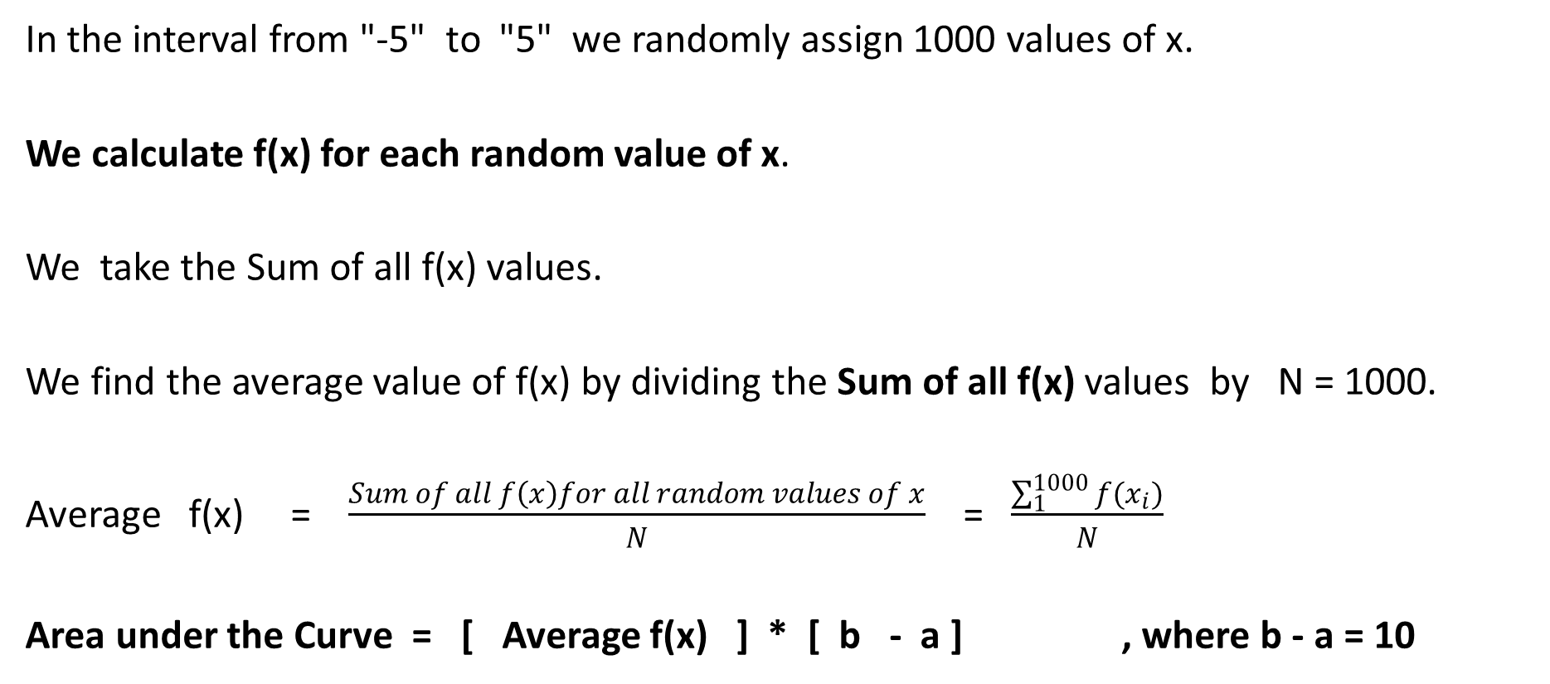
Monte Carlo Method of Integration
In the interval from "-5" to "5" we randomly assign 1000 values of x.
We calculate f(x) for each random value of x.
We take the Sum of all f(x) values.
We find the average value of f(x) by dividing the Sum of all f(x) values by N = 1000.
Average f(x) = $\frac{Sum of all f\left(x\right)for all random values of x}{N}$ = $\frac{\sum_{1}^{1000}{f(x_{i})}}{N}$
Area under the Curve = [ Average f(x) ] * [ b - a ] , where b - a = 10

Slide 11
Results from Monte Carlo Method of Integration
Monte Carlo Method
N | Area
50 | 0.7654
100 | 1.4857
200 | 0.8133
400 | 1.0367
800 | 0.9991
1000 | 1.1019
2000 | 1.0001
4000 | 0.9807
8000 | 1.0871
16000 | 1.0379
32000 | 1.0290
64000 | 1.0464
Note: Monte Carlo Randomness seems to stabilize at large values of N.

Slide 12
%Numerical Integration %Monte Carlo Method
% TO AVOID DIVISION BY ZERO, PROBLEM IS DIVIDED INTO LEFT AND RIGHT
%*******************************************************************
%Interval for x = [a,b] for LEFT SIDE
a = -5;
b = -0.01;
%Input value for N
N = 2000 ;
%Column Vector x to store random values of x for Left Side
x = zeros(N,1);
%Randomly Generate x values between -5 and 0
x = (b-a).*rand(N,1) + a;
%Calculate Area on Left Side
AREA_left = 0;
%**************************************************************
%Monte Carlo Formula; Area = (Sum of all f(x))*(b-a)/N
%**************************************************************
for i = 1:N
AREA_left = AREA_left + (b-a)*func_1(x(i,1));
end
%Divide by N because Area = average f(x) times width from b to a
AreaLeftAverage = AREA_left/N ;
%*******************************************************************
%Interval for x = [a,b] for Right SIDE
a = 0.01;
b = 5;
%Column Vector x to store random values of x for Right Side
x = zeros(N,1);
%Randomly Geenerate x values between 0 and 5
x = (b-a).*rand(N,1)+a;
%Calculate Area on Right Side
AREA_right = 0;
%**************************************************************
%Monte Carlo Formula; Area = (Sum of all f(x))*(b-a)/N
%**************************************************************
for i = 1:N
AREA_right = AREA_right + (b-a)*func_1(x(i,1));
end
%Divide by N because Area = average f(x) times width from b to a
AreaRightAverage = AREA_right/N ;
%**************************************************************
% Add the Area on the left side to the Area on the right side
AREA = AreaLeftAverage + AreaRightAverage;
AREA

Slide 13
Comparison of Results
Midpoint Composite |  | Trapezoidal for Romberg |  | Romberg Extrap | Monte Carlo Method
N | Area | N | Area | Area | N | Area
50 | 1.1454 | 1 | -3.8838 |  | 50 | 0.7654
100 | 1.2675 | 2 | -1.5907 |  | 100 | 1.4857
200 | 1.0392 | 4 | 1.6256 |  | 200 | 0.8133
400 | 1.0423 | 8 | 1.4034 |  | 400 | 1.0367
800 | 1.0429 | 16 | 0.8566 |  | 800 | 0.9991
1000 | 1.0429 | 32 | 1.0234 |  | 1000 | 1.1019
2000 | 1.0430 | 64 | 0.9928 |  | 2000 | 1.0001
 |  | 128 | 1.0245 |  | 4000 | 0.9807
 |  | 256 | 1.0352 |  | 8000 | 1.0871
 |  | 512 | 1.0408 | 1.0430 | 16000 | 1.0379
 |  |  |  |  | 32000 | 1.0290
 |  |  |  |  | 64000 | 1.0464
Note: Monte Carlo Randomness seems to stabilize at large values of N.

